Slide 1
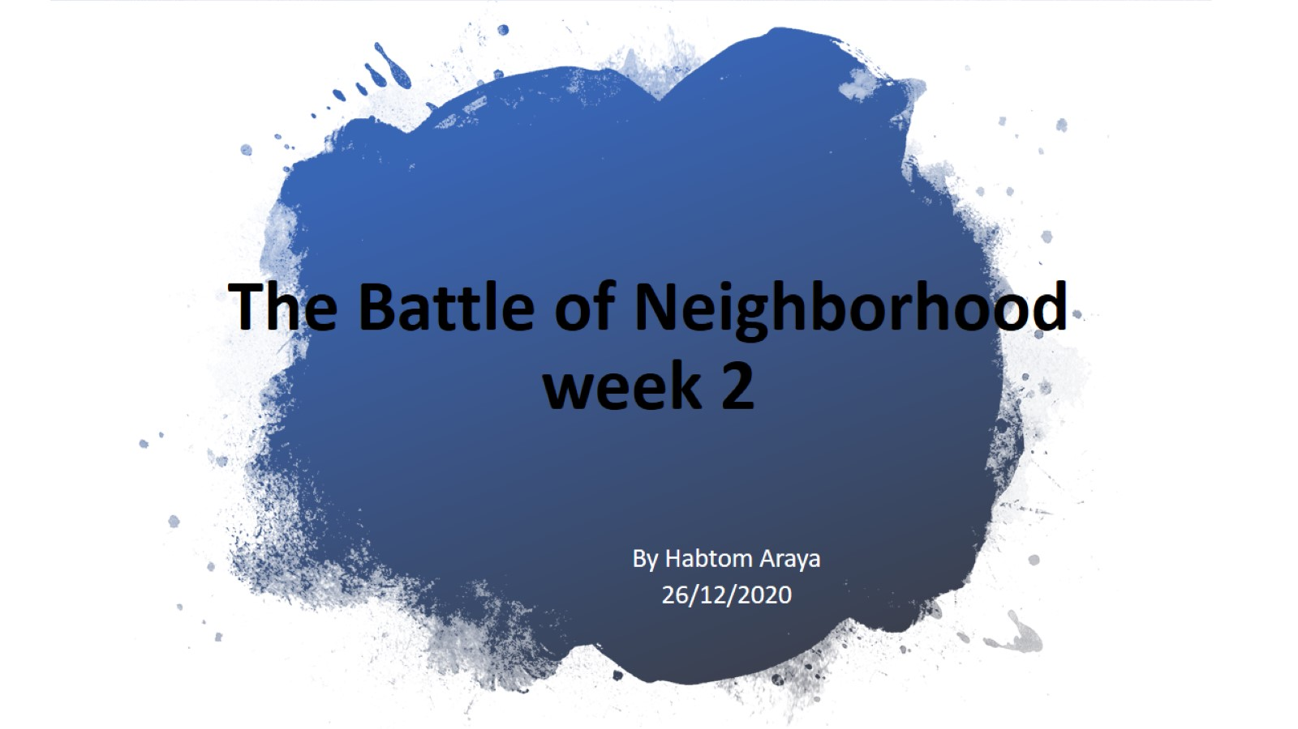
The Battle of Neighborhood week 2

Slide 2

Introduction/Business Problem

Slide 3
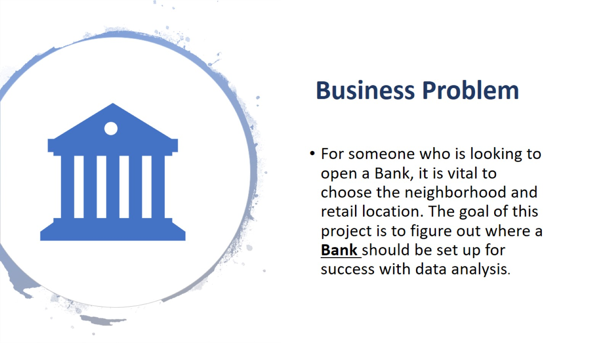
Business Problem

Slide 4
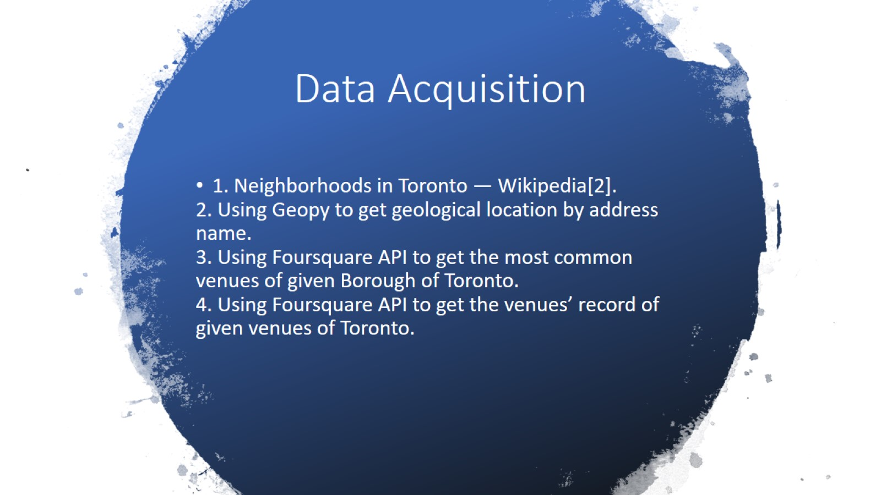
Data Acquisition

Slide 5
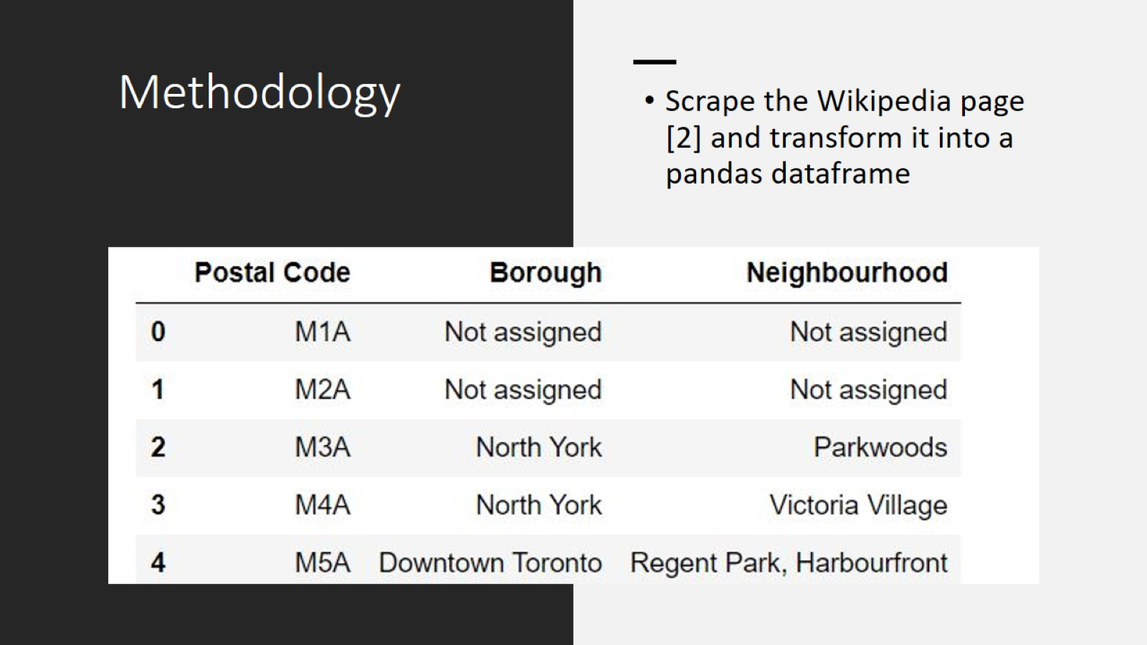
Methodology

Slide 6
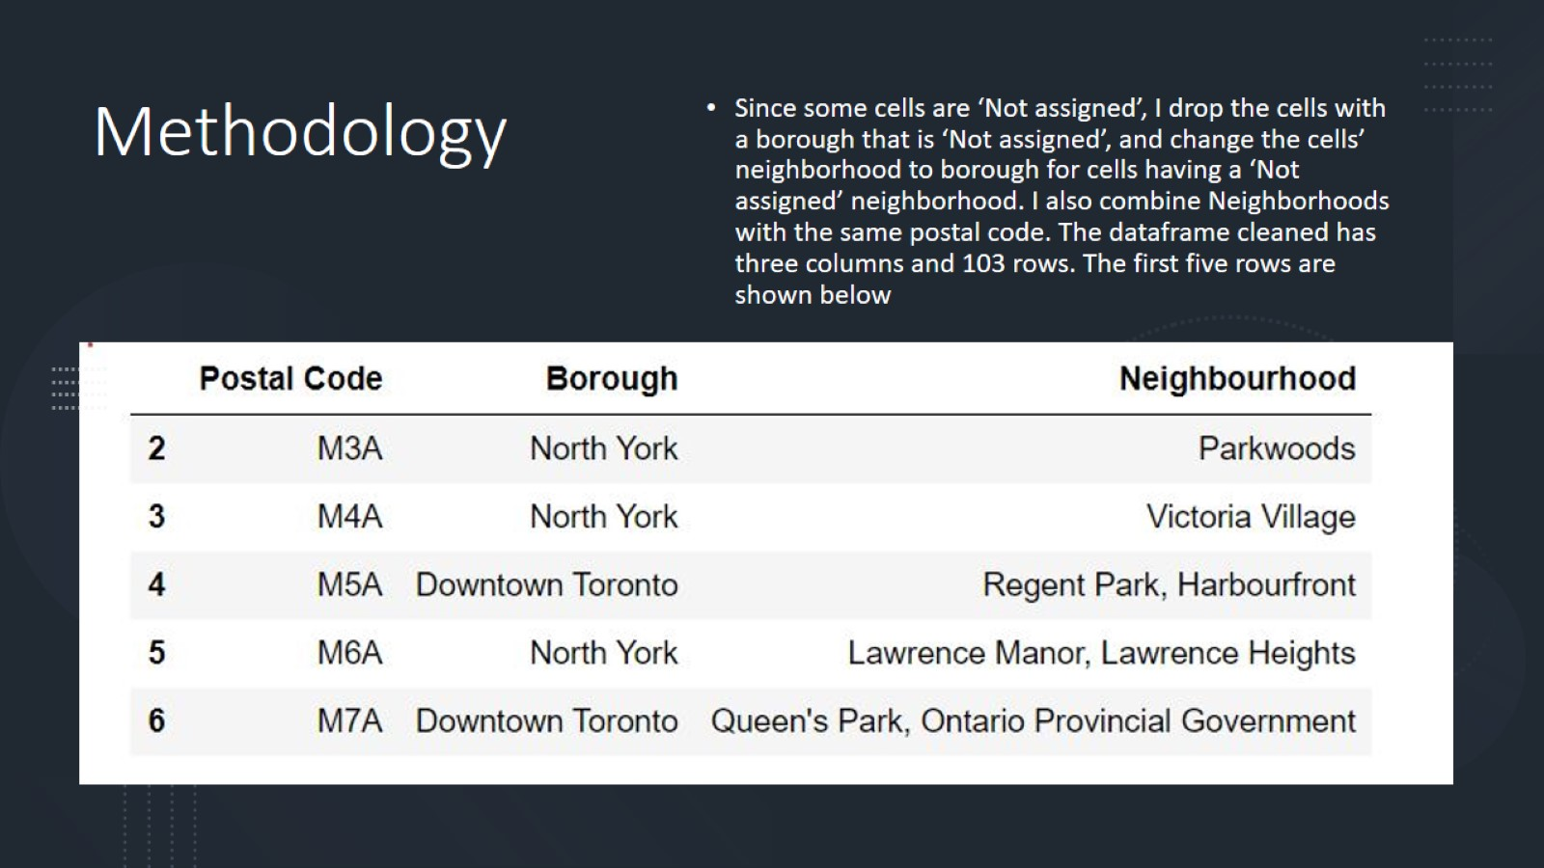
Methodology

Slide 7
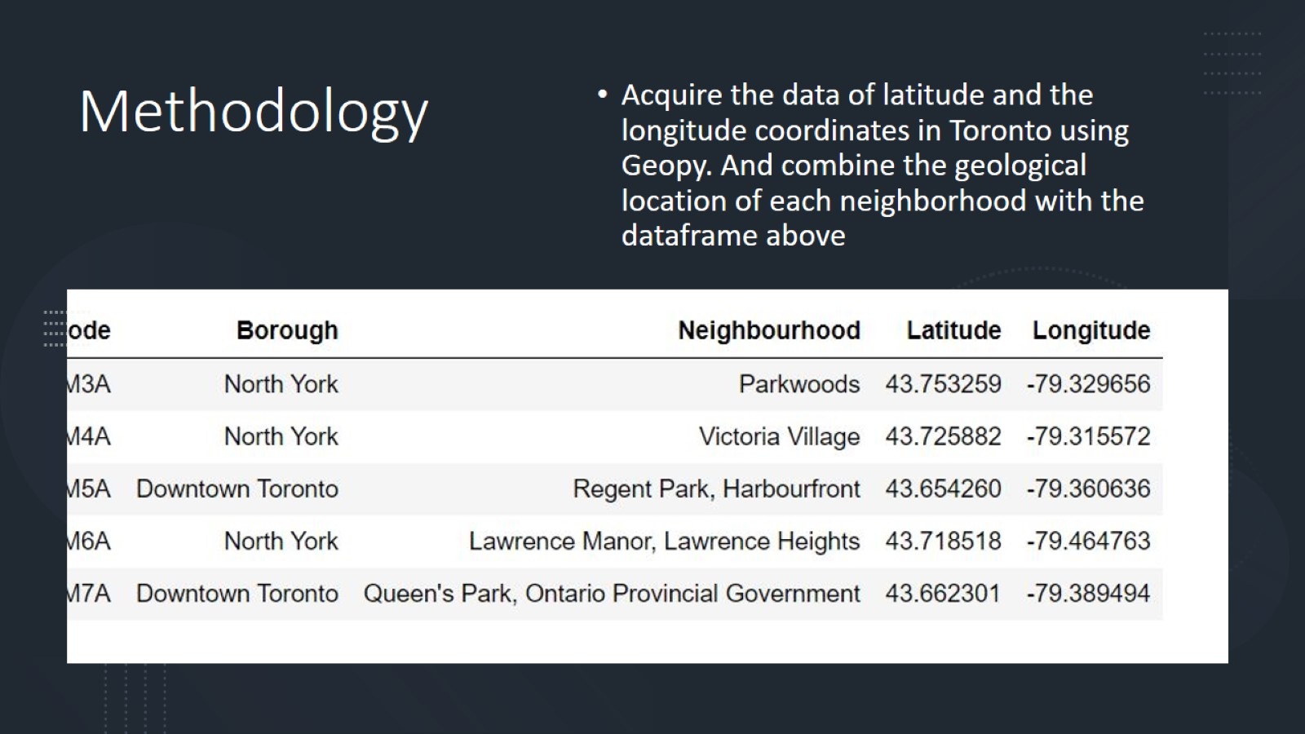
Methodology

Slide 8
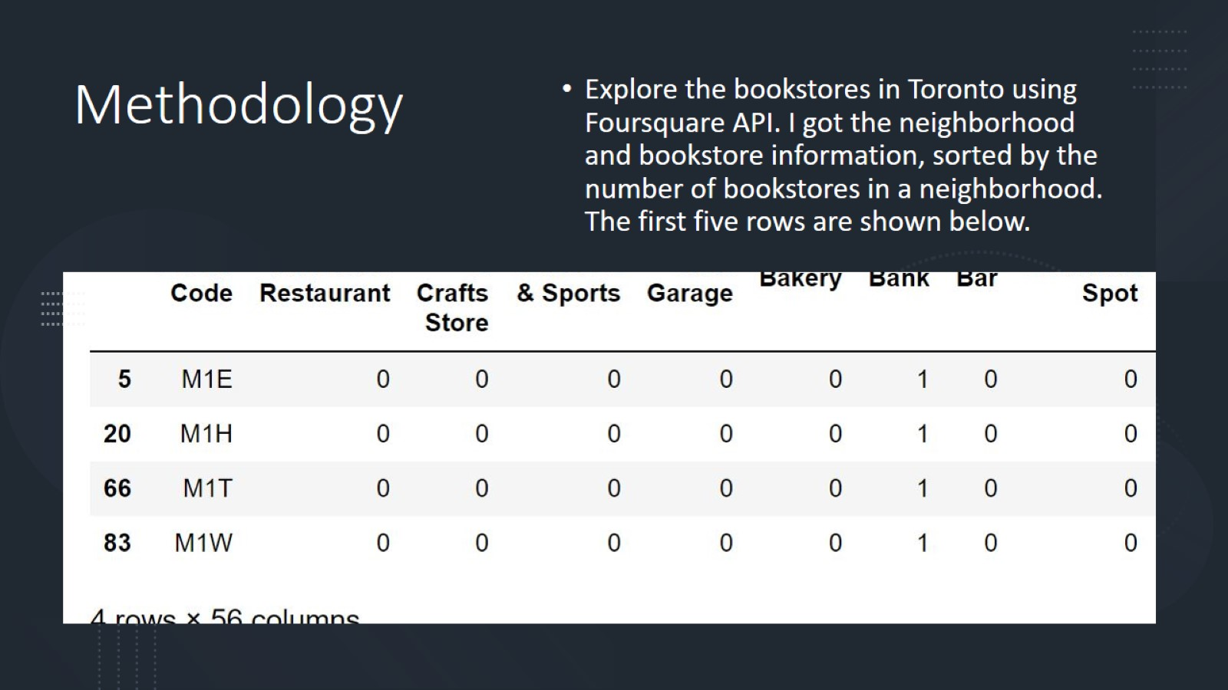
Methodology

Slide 9
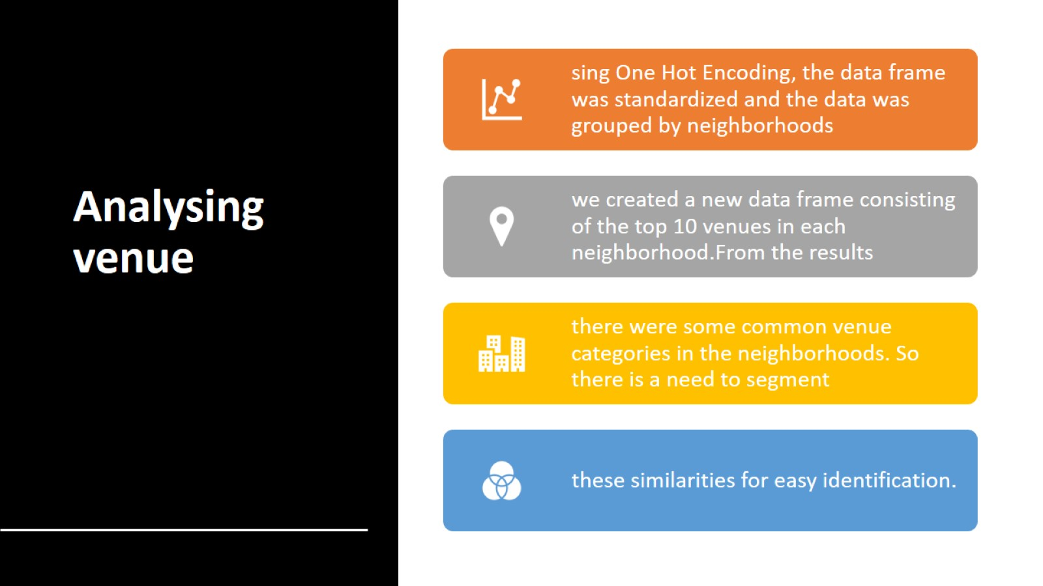
Analysing venue

Slide 10
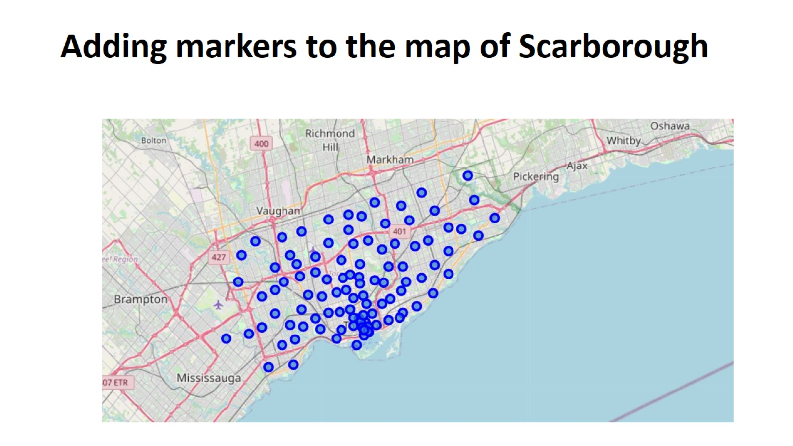
Adding markers to the map of Scarborough

Slide 11
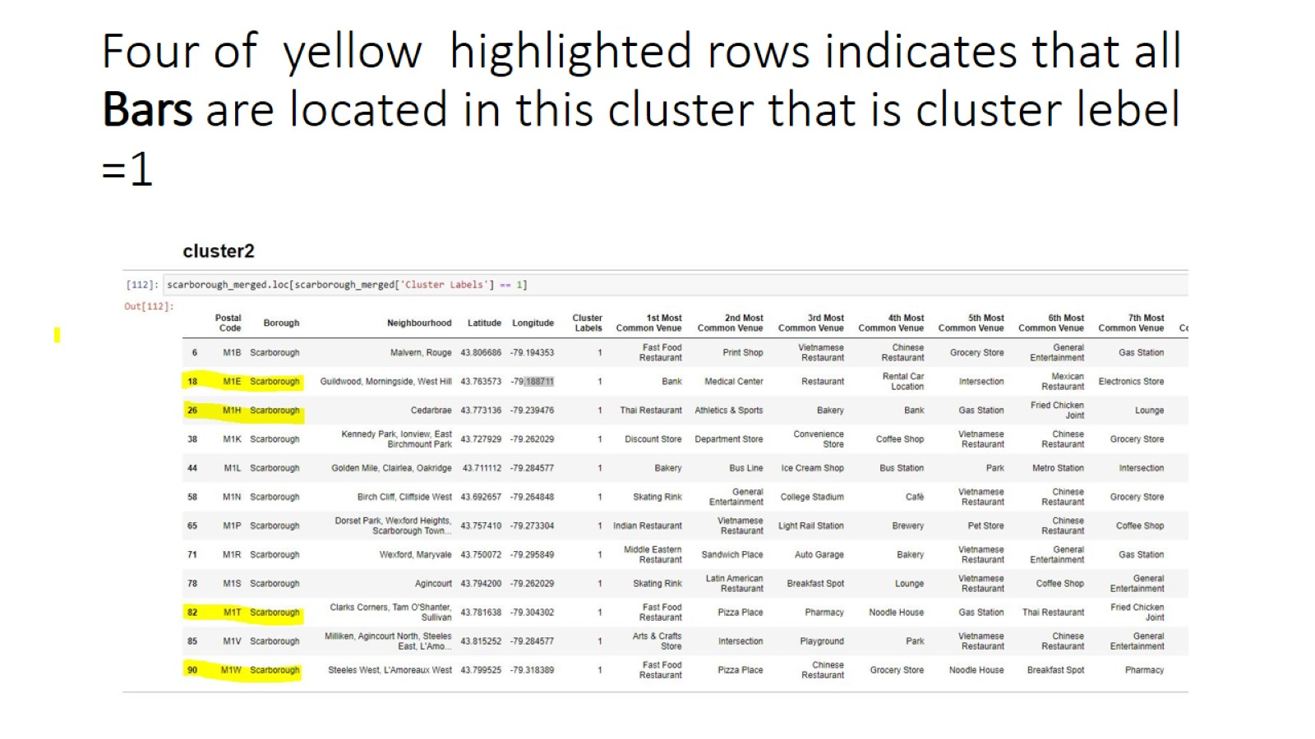
Four of yellow highlighted rows indicates that all Bars are located in this cluster that is cluster lebel =1

Slide 12
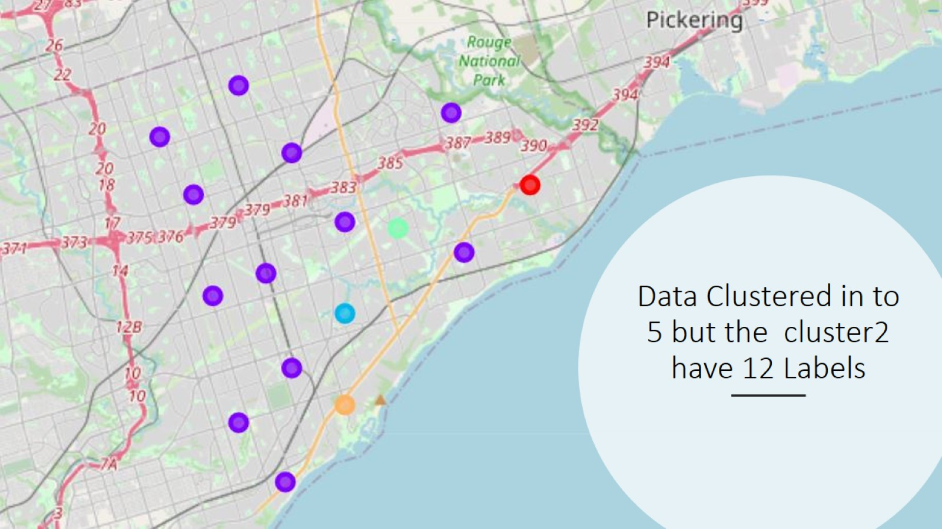
Data Clustered in to 5 but the cluster2 have 12 Labels

Slide 13
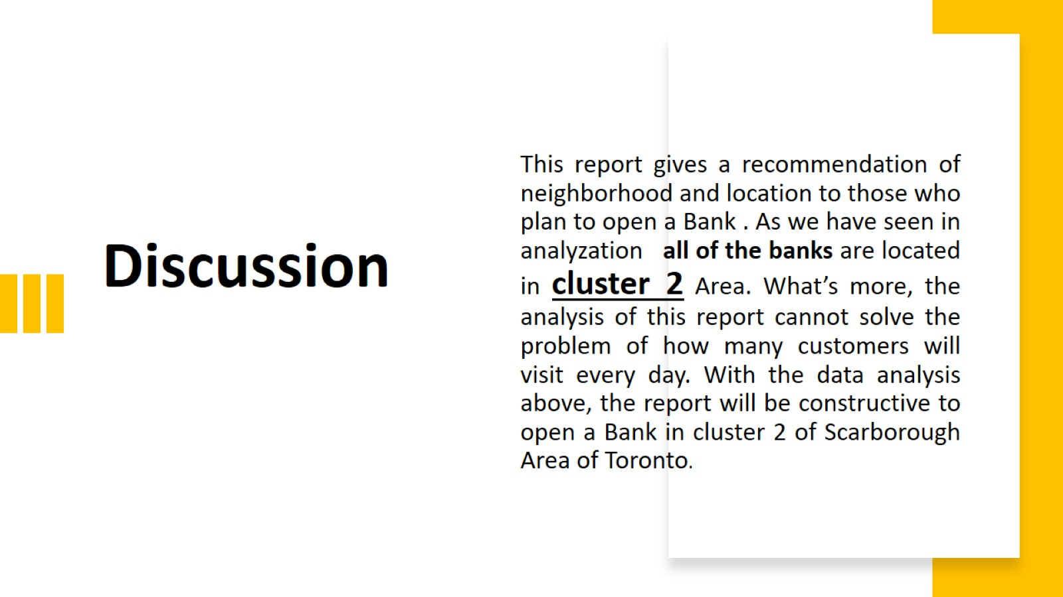
Discussion

Slide 14
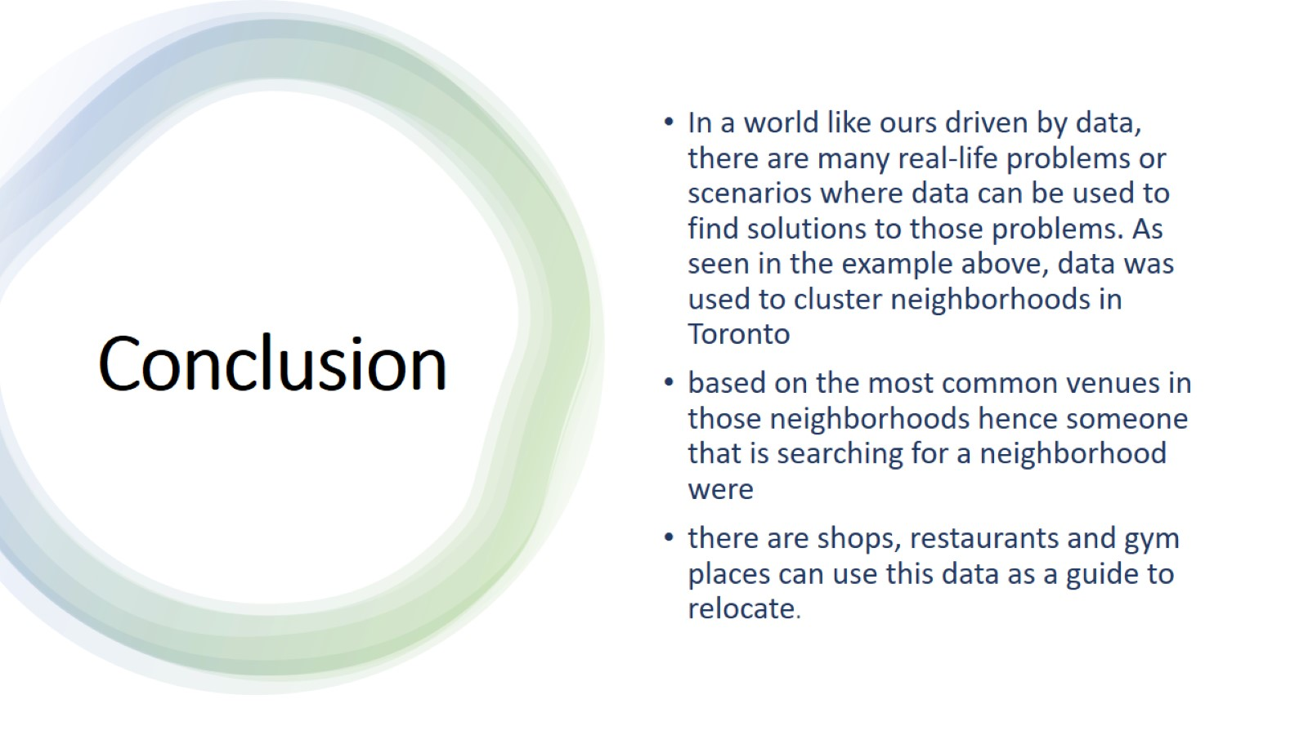
Conclusion

